Slide 1
Audio and Video Editing
Travis Gasque
Kevin Tang

Slide 2

Editing
Software
Leveling, Compressing, EQ
Video
Publishing

Slide 3

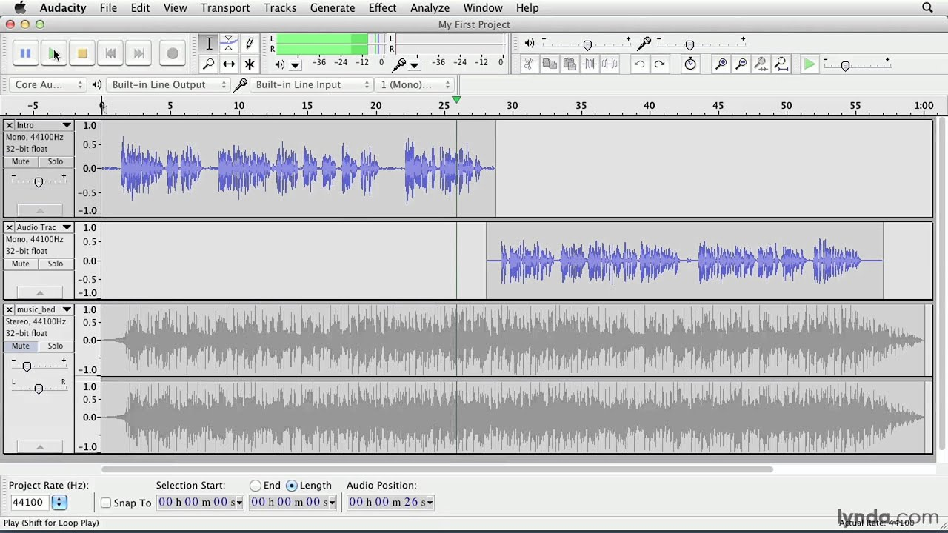
Software (Audio)
File format
  .wav, .aif
Audacity
  Free waveform editor
Digital Audio Workshop (DAW)
  FL Studio, Ableton, Reaper…
  Geared towards music production

Slide 4
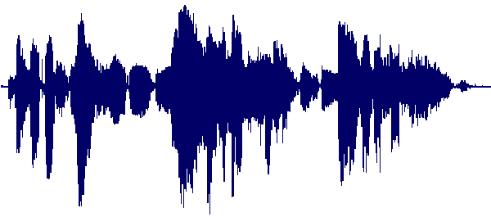
Leveling
Get rid of big peaks of noise
Normalize audio across the entire clip
  Important to see waveform
  Shooting for -18 dB to -16 dB

Slide 5
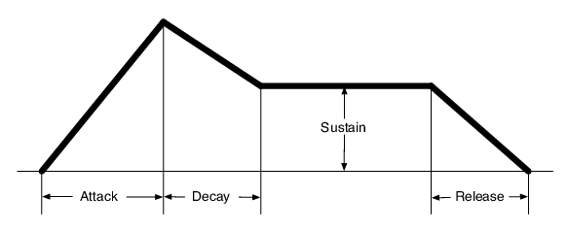
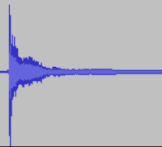
Compression
Transient
Reduce the transient, or initial impulse of sound
  Produces a more even sound
Threshold
  dB level at which compression starts
Ratio
  How much the transient is reduced
A little goes a long way
  -16dB threshold
  2:1 or 3:1 ratio
ADSR Envelope

Slide 6
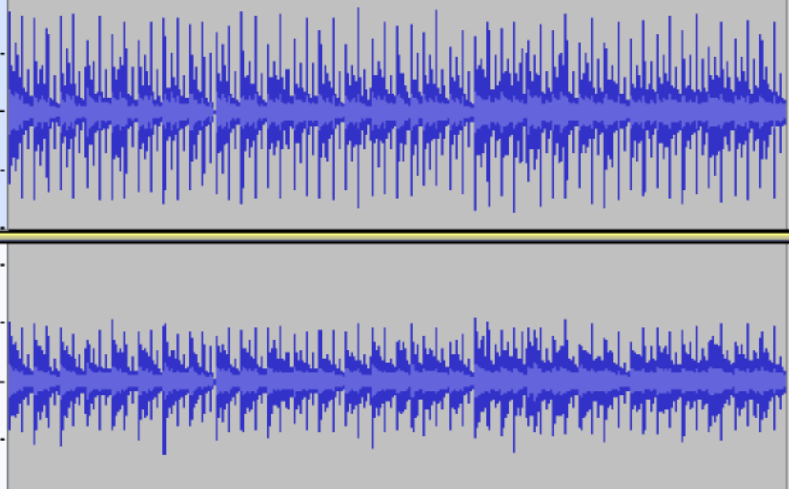
Compressed vs. Uncompressed

Slide 7
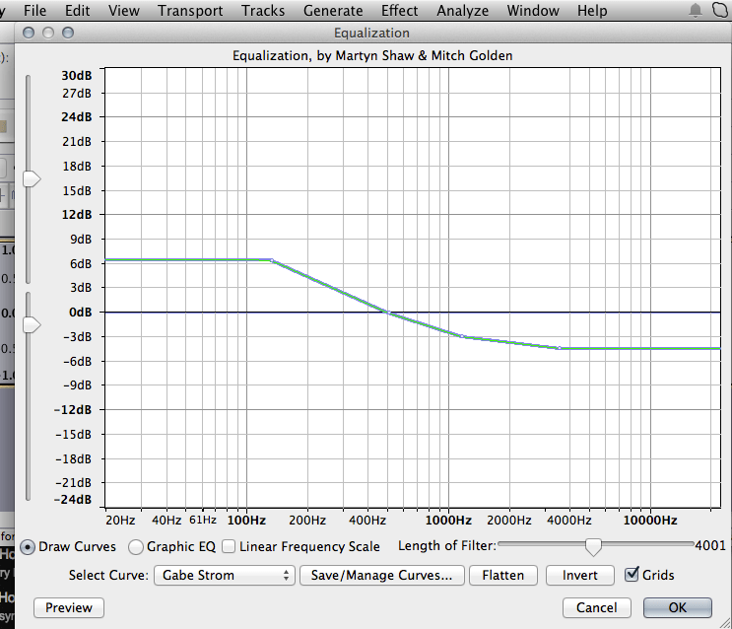
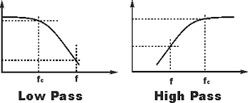
Equalization (EQ)
The raising or lowering of certain frequencies
  We hear 20Hz to 20,000 Hz
  Human speech is around 1000 Hz to 5000 Hz
High Pass Filter (HPF)
  Lets frequencies higher than cutoff pass
  ~100Hz
  Don’t use built in HPF unless necessary
Low Pass Filter (LPF)
  Lets frequencies lower than cutoff pass
  Usually not used

Slide 8
Denoising
De-essing
Gets rid of background hums
Obviously, it’s preferable to just record in a good environment, but that’s not always possible
Gets rid of sibilance, or “s” noises

Slide 9
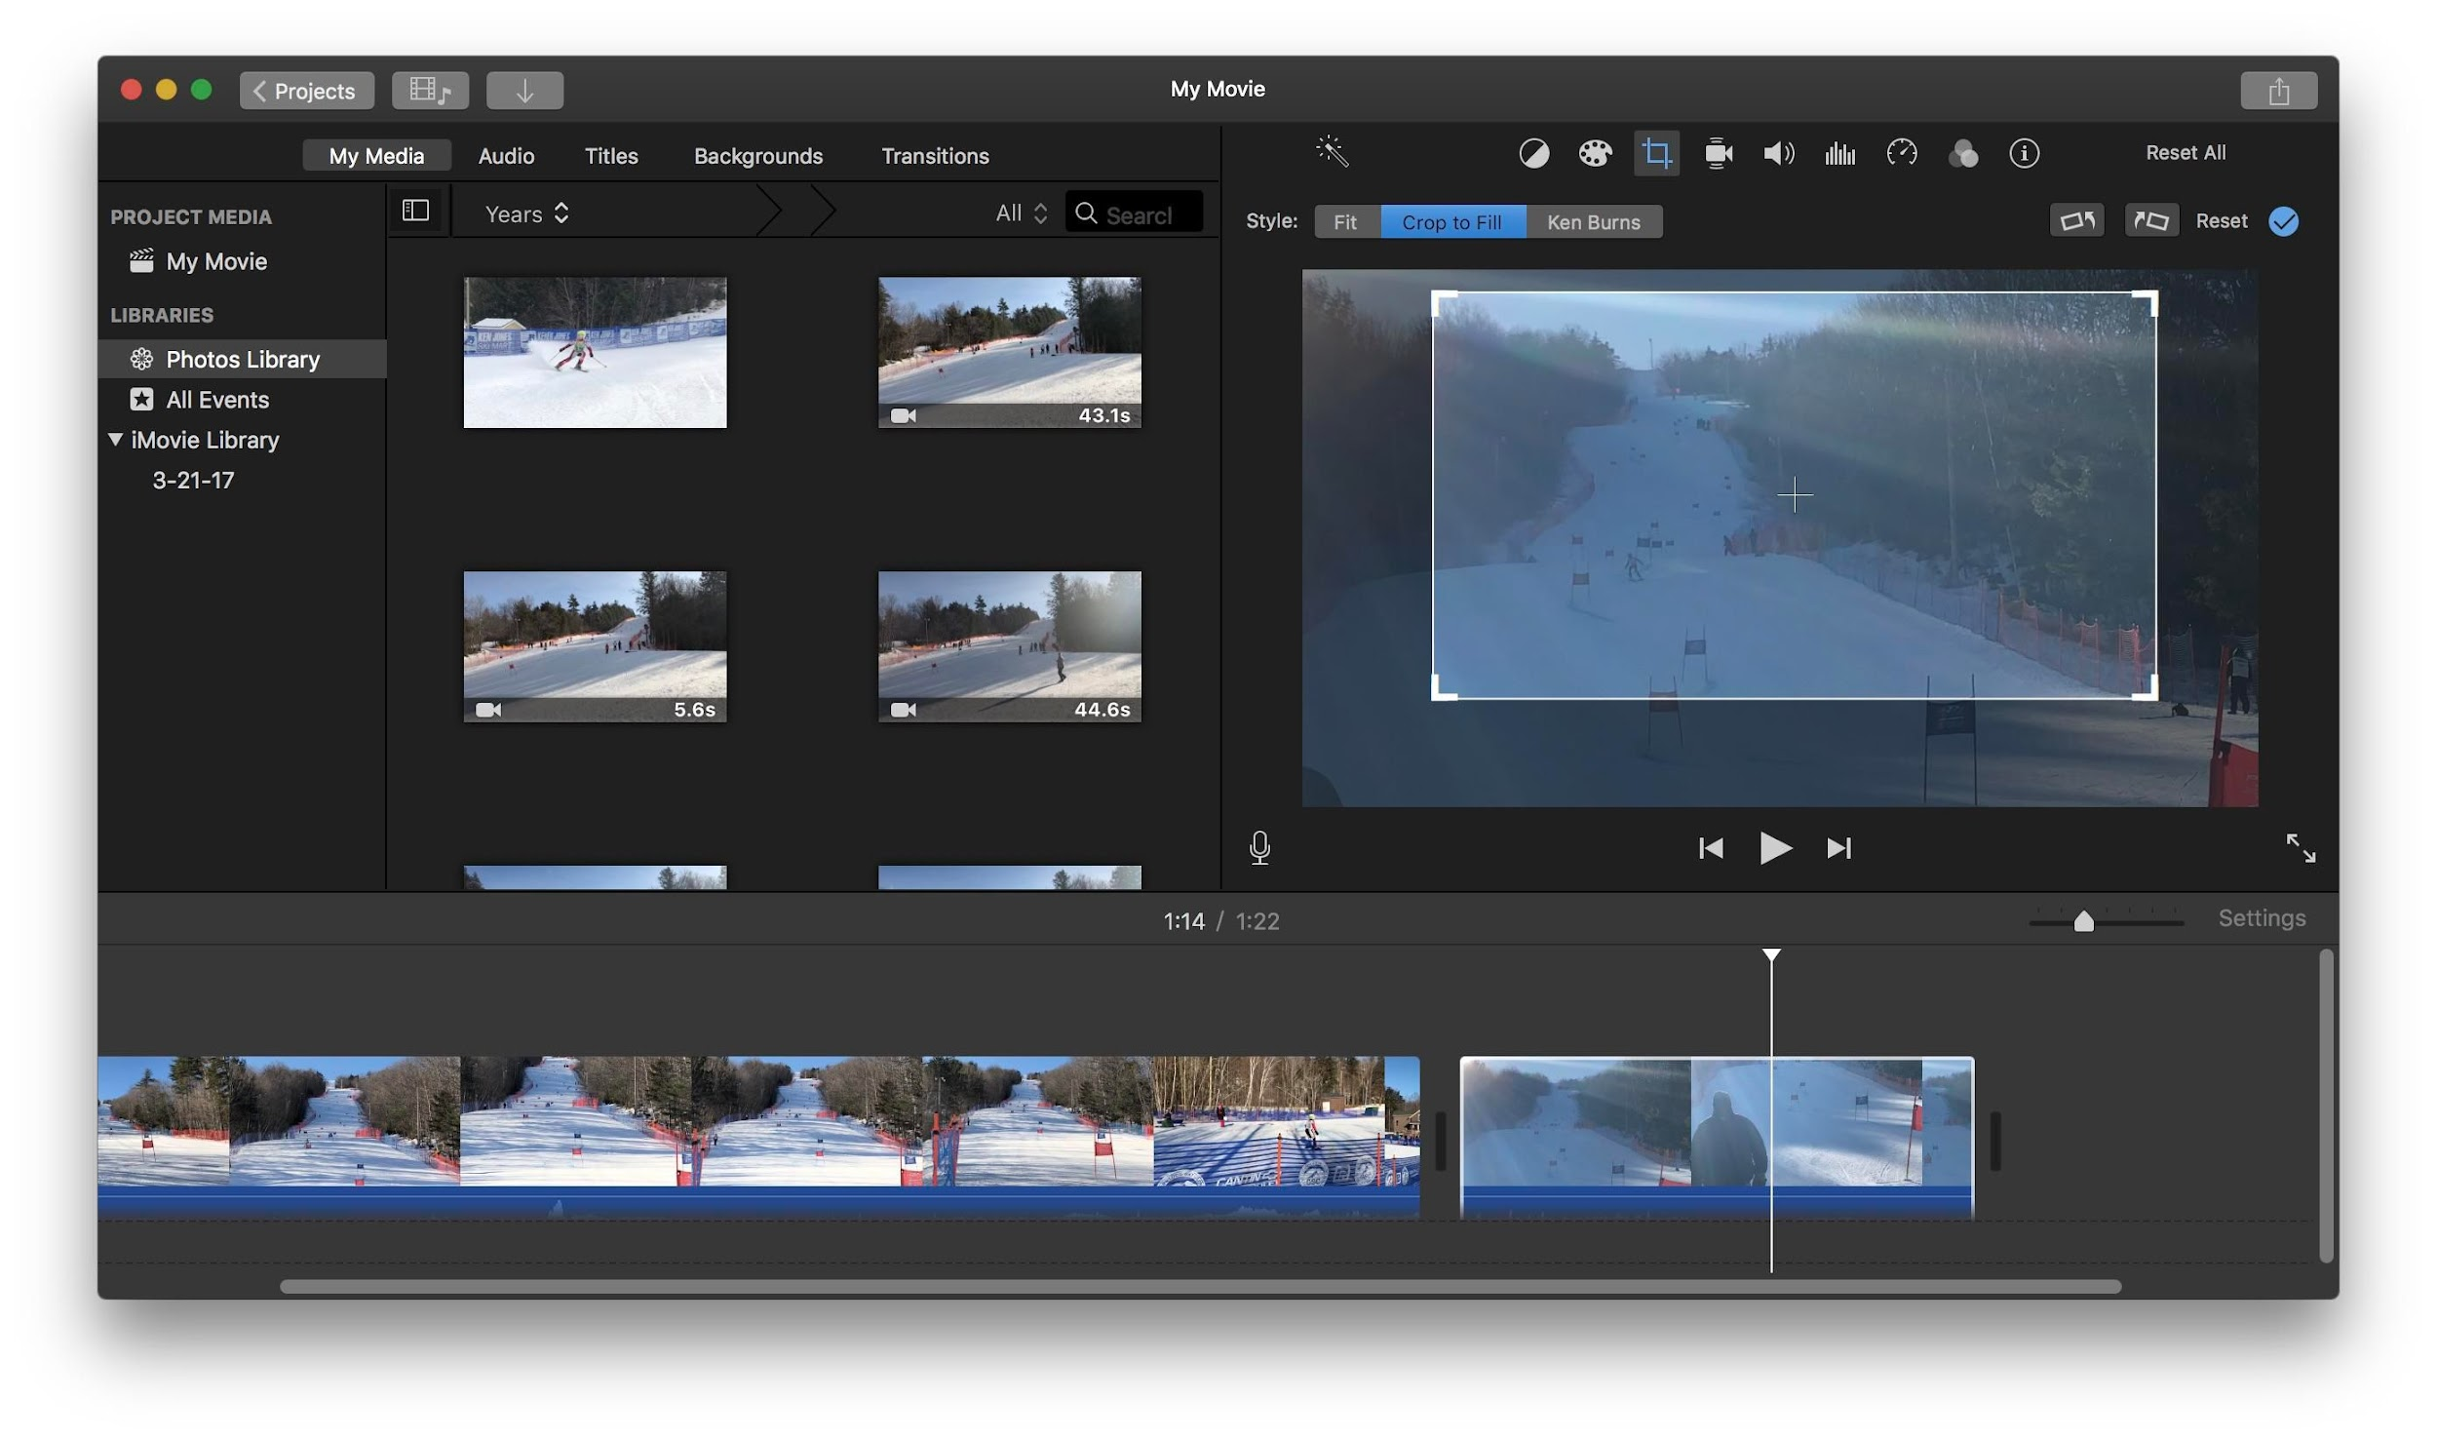
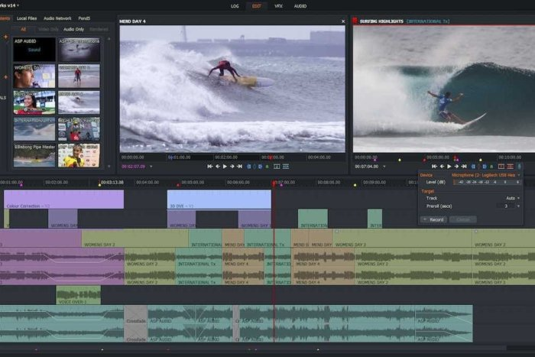
Software (Video)
File format
  .mp4
  H.264 codec
iMovie (Mac)
Lightworks (Windows)

Slide 10
Questions?

