Slide 1
Recording
Audio + Visuals
Travis Gasque
Kevin Tang

Slide 2
Preface
The field of Audio and Visuals is really large
Podcasting-focused
  How to record, with a focus on spoken interview
  In studio and on the field
  Tips & Tricks

Slide 3
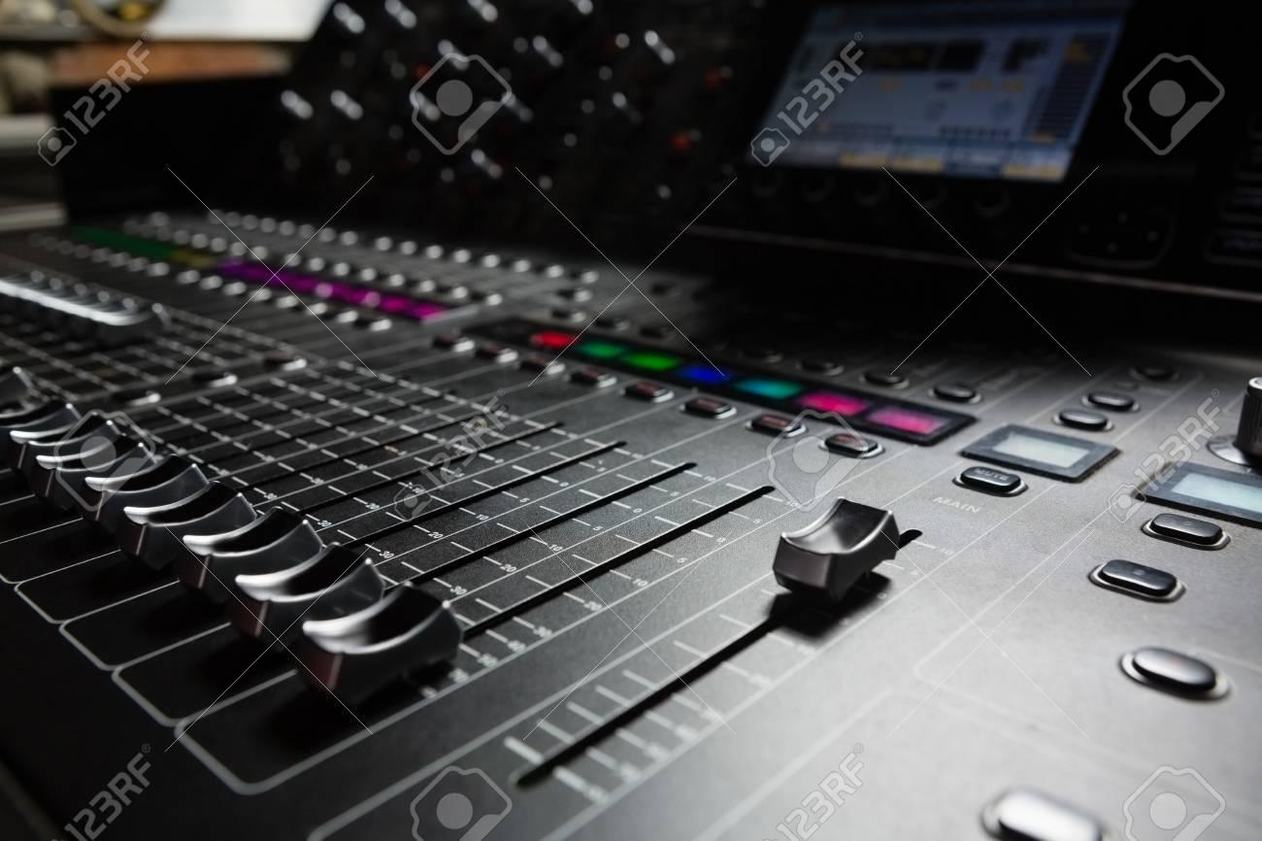
Recording
Basic Equipment
Setting up your Environment
General good practices

Slide 4

Why start here?
Good source audio makes editing 100x easier
On the contrary…
  Bad audio can be impossible to edit

Slide 5
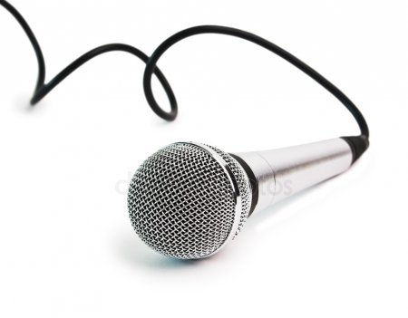
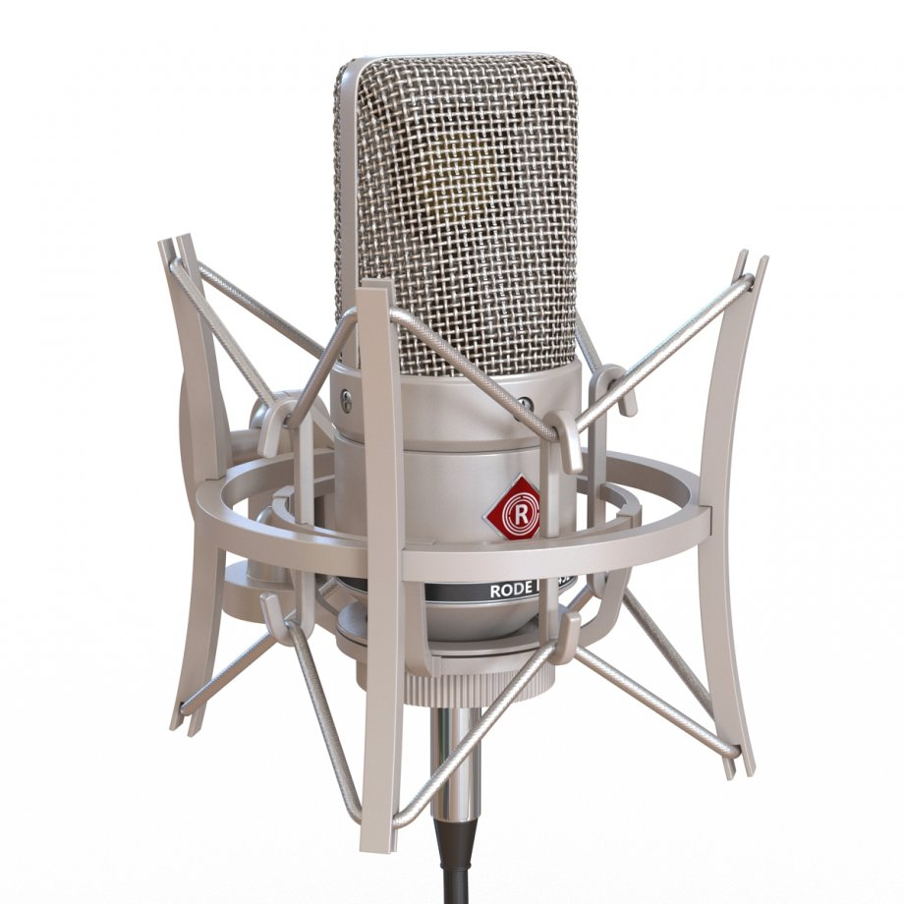
Equipment - Microphone
Dynamic
Versatile
Rugged
Smaller Range
Condenser
Best sound quality
Fantastic Range
Unforgiving
Delicate

Slide 6
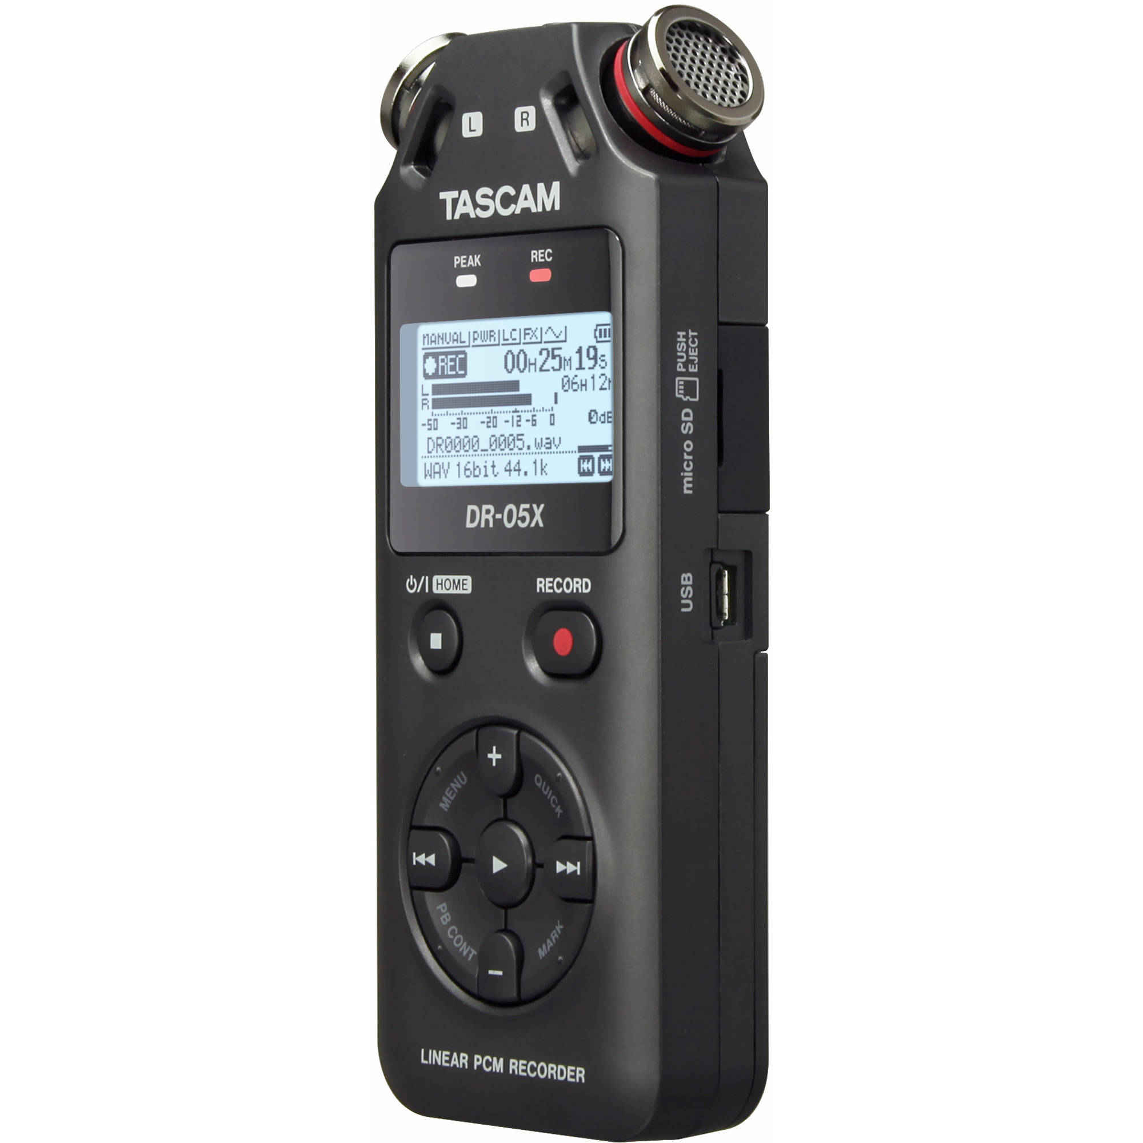
Equipment - Recorder
Handheld audio recorders
Many versions have dedicated inputs for microphones
Lets you record high fidelity audio files without a computer

Slide 7
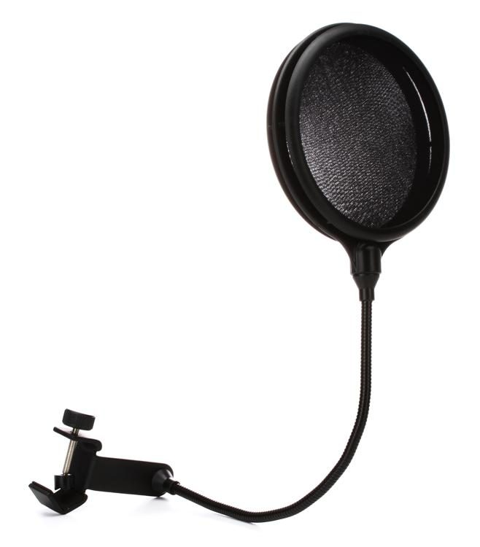
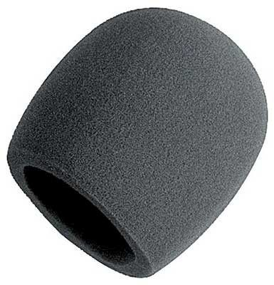
Equipment - Filters
Pop Filters
Eliminate pops from “p” and “b” sounds
Also saliva...
Windscreen
Block noise from wind
Mostly for outdoor use

Slide 8
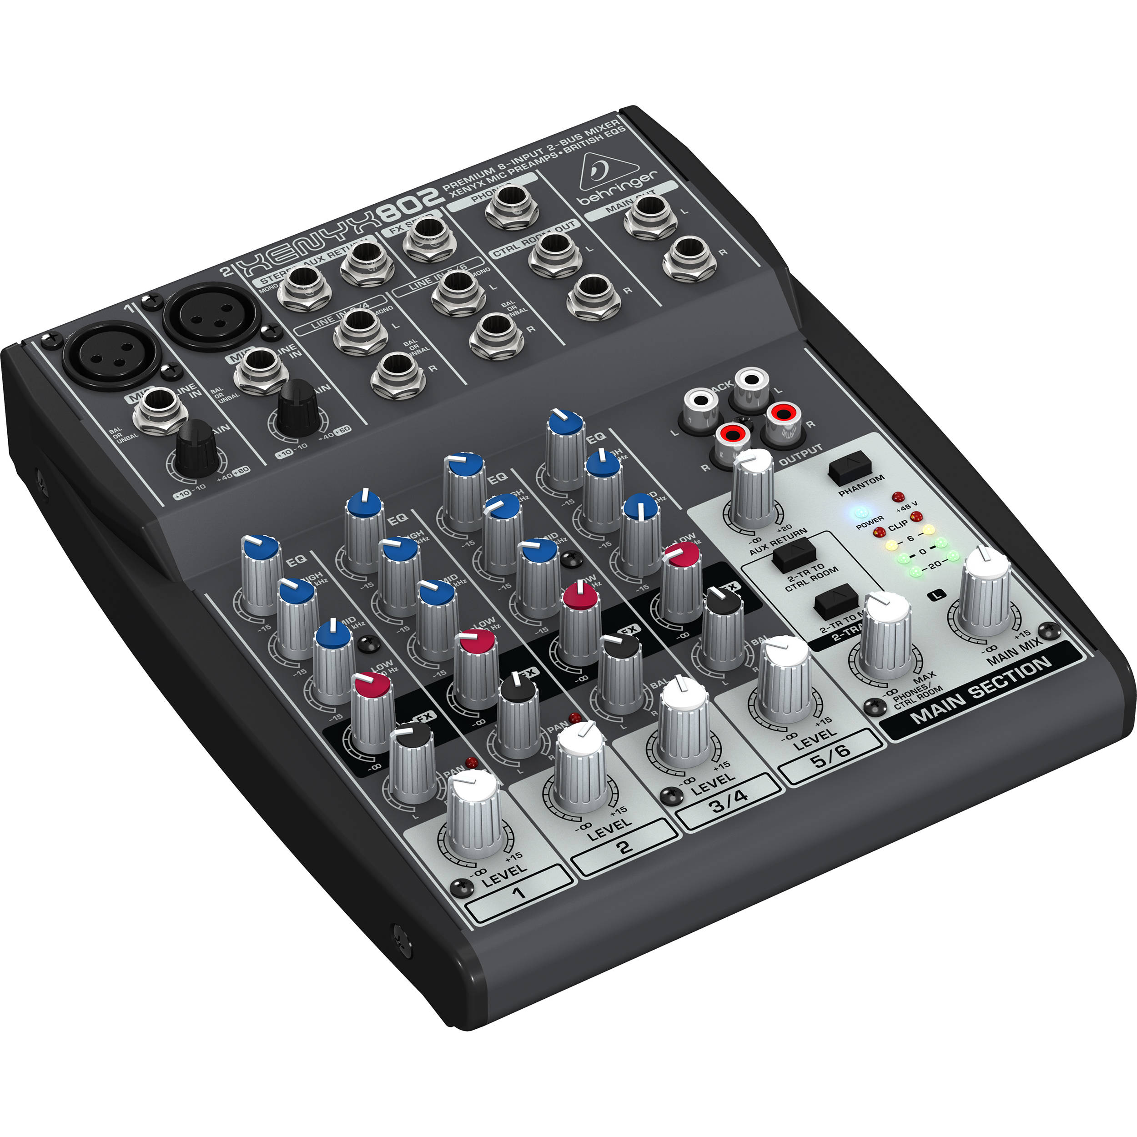
Equipment - Mixer
Lets you balance audio levels from multiple inputs
Range from huge 24-track boards to small portable mixers
Let’s you balance your audio before you go into post production

Slide 9
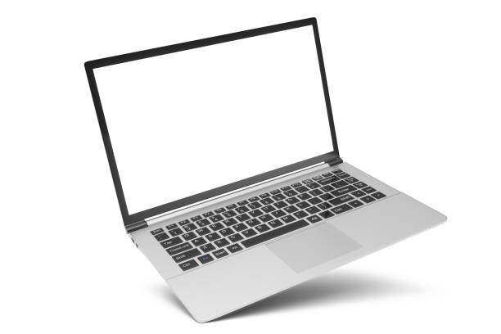
Setups
Studio setup: Condenser -> Mixer -> Computer
...But there is no hard and fast rule on setups
On the road: Dynamic -> Recorder

Slide 10
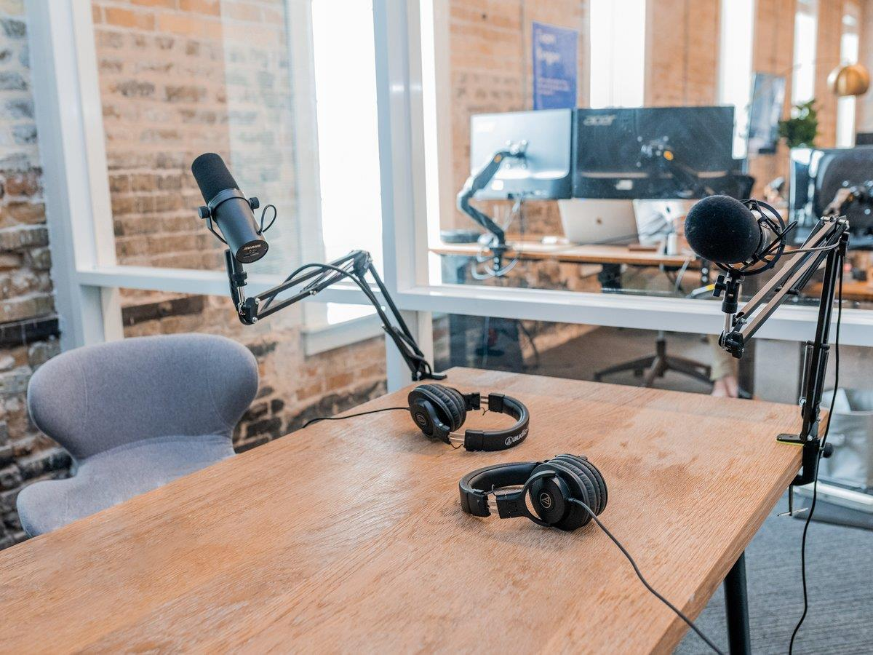
Tips & Tricks
“Eat the mic”
Whenever possible, find a quiet environment
Listen to your audio!
  Most recorders have a direct out for headphones so you can monitor in real time
Bring cables
Have a backup plan

Slide 11
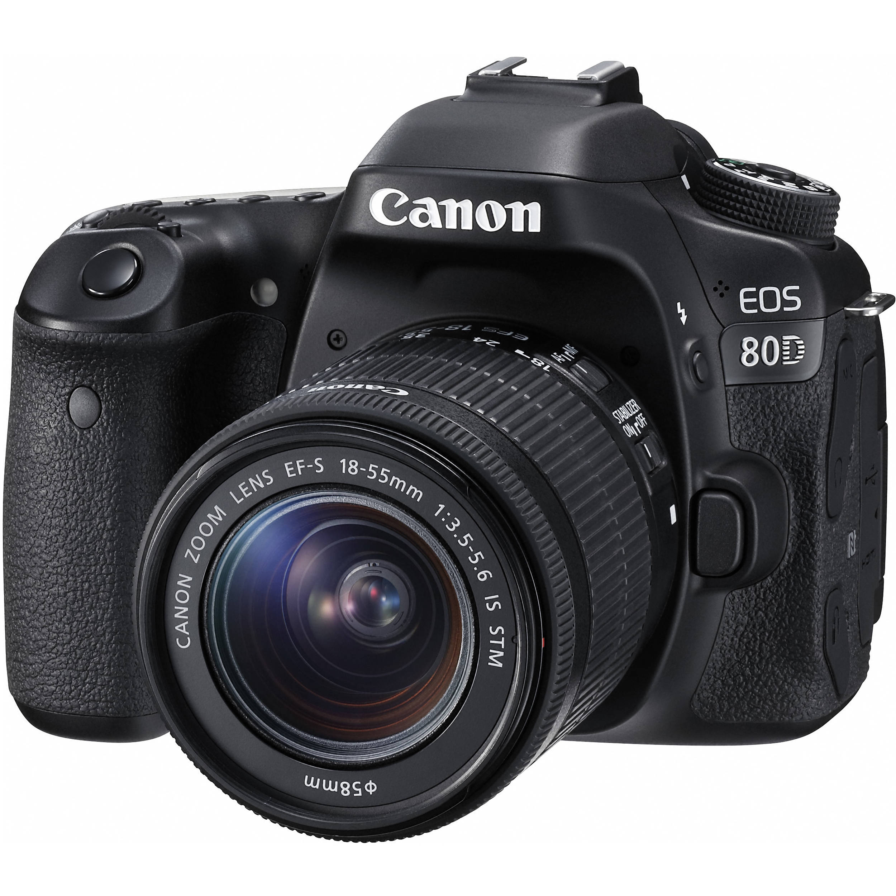
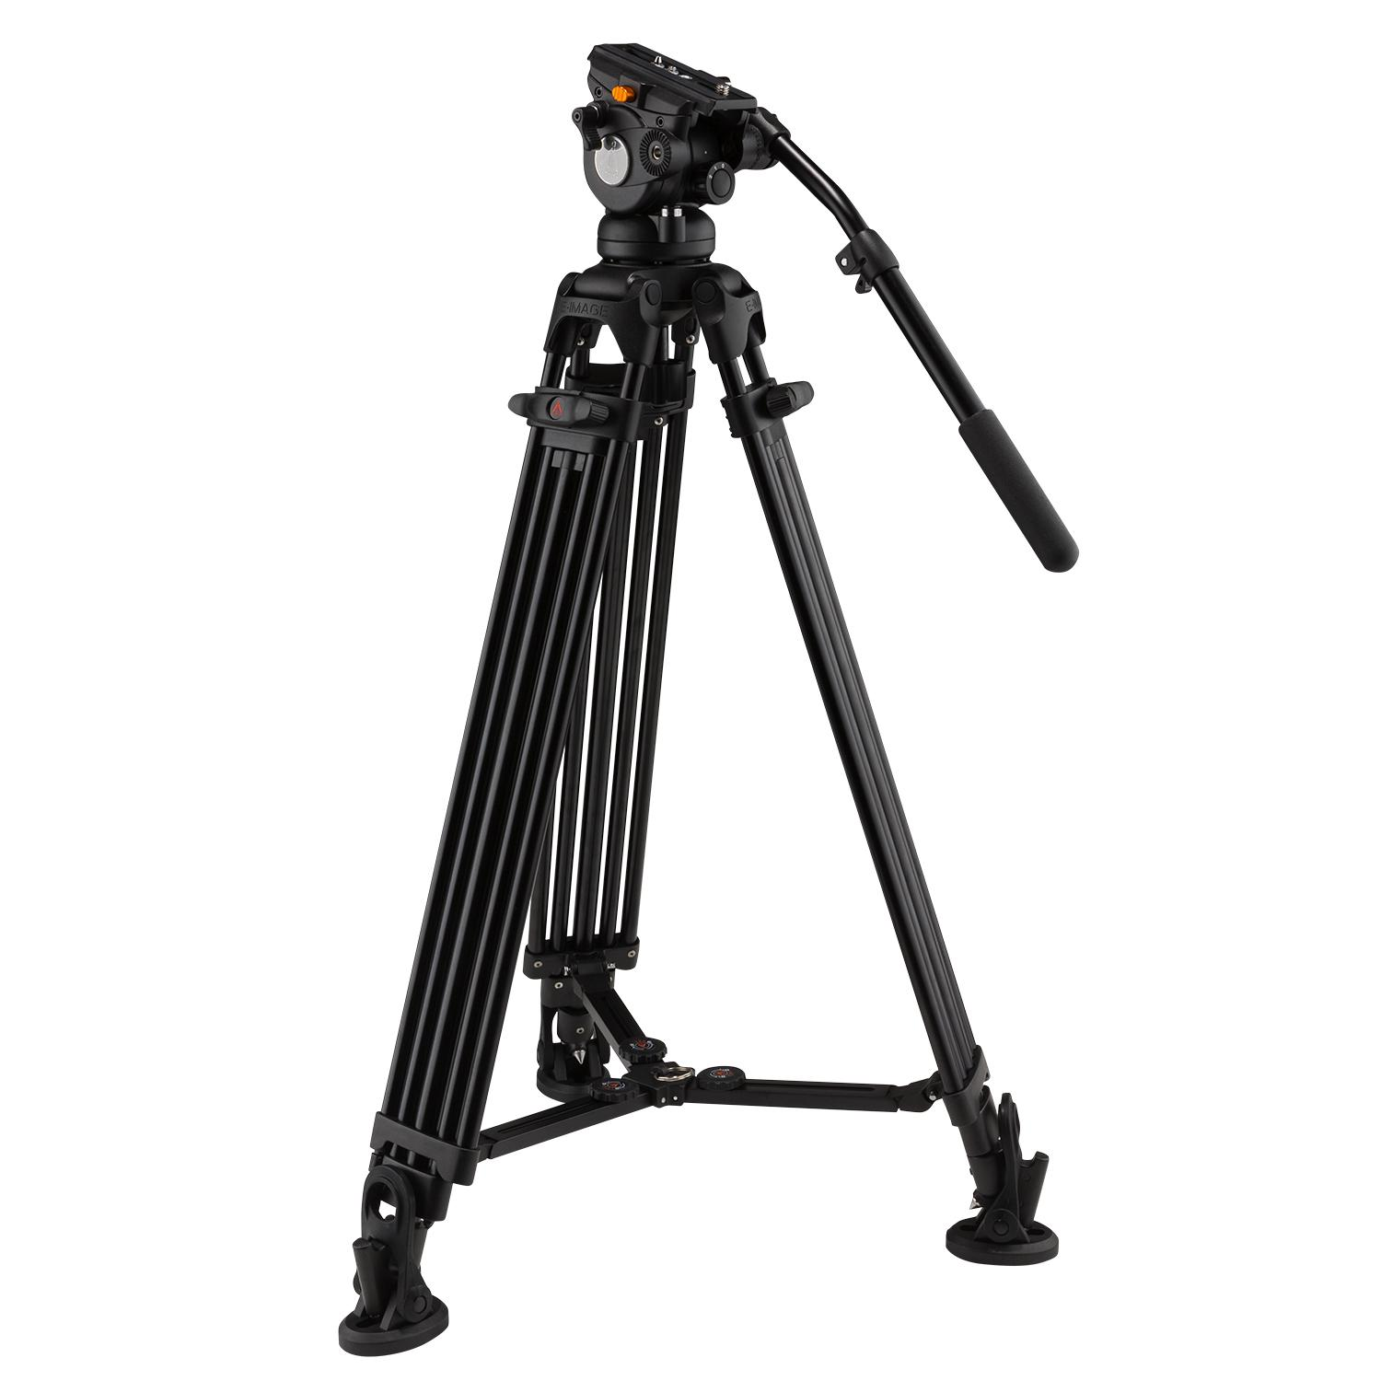
Equipment - Cameras
DSLR, Smartphone, Video Cameras…
  Most options will give you good enough video quality if image quality isn’t the primary focus
  But DSLR or other equivalent vastly preferred
A tripod is a must!
  Even if recording moving shots, a tripod will make it much smoother

Slide 12
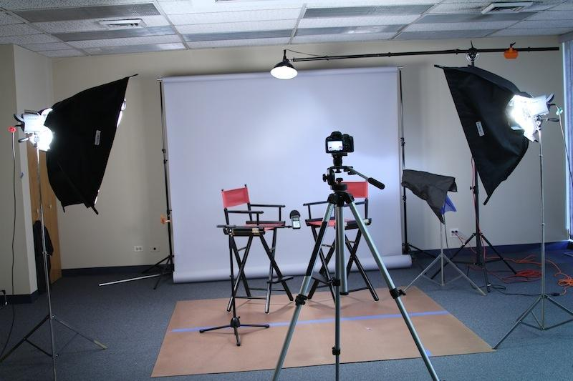
Tips & Tricks
Document everything
  Like, really
Video > Image
  Can separate images from video later
Record audio and video separately
Clap to sync
Don’t look at the camera

Slide 13
Questions?

