Slide 1
Physical Prototyping
Travis Gasque
DILAC Lab
Adapted from Courtney Allen’s work

Slide 2
Definitions - Physical Computing
Building interactive physical systems by the use of software and hardware that can sense and respond to the analog world.
A creative framework for understanding human beings' relationship to the digital world.
Handmade art, design or DIY hobby projects that use sensors and microcontrollers to translate analog input to a software system, and/or control electro-mechanical devices such as motors, servos, lighting or other hardware.

Slide 3
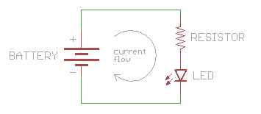
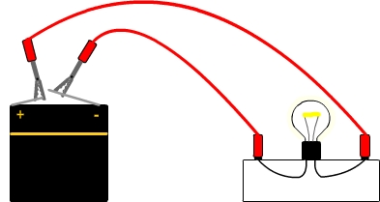
Basic Circuits
Current flows from Positive (+) to Negative (-)*
Always complete your circuits. Open circuits lead to problems**
*Ground is often used as a way to safely dissipate the electricity in the circuit if open.
**Problems include: Electrocution, Blown Components, and Fires.
Notes:
Ohm’s Law: V=IR - Voltage = Current * Resistance
Basics of all circuits. To make anything work they have certain voltage/current rating, you then adjust the I,V, or R to not blow it out.

Slide 4
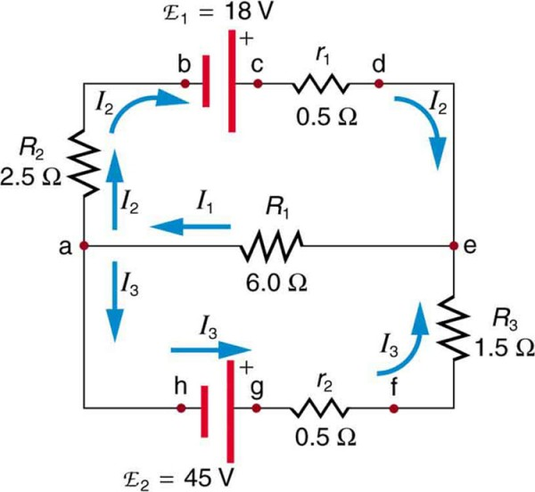
Advanced Circuits
It becomes complex math.
Image’s mathematical form: −I₂R₂ + emf₁ − I₂r₁ − I₁R₁ = −I₂(R₂ + r₁) + emf₁ − I₁R₁ = 0.
Contact ECE if your circuit gets this advanced.
Notes:
Image is an example of Kirchhoff’s Rule: i1 = i2 +i3

Slide 5
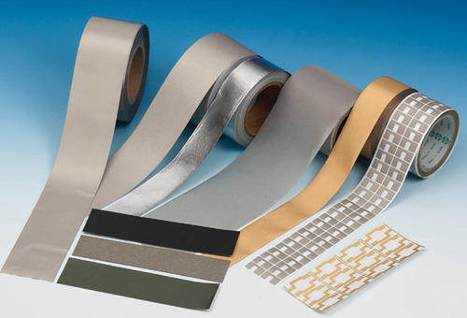
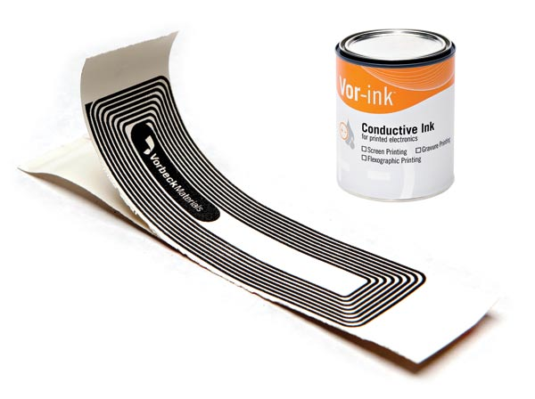
Prototyping Material

Slide 6
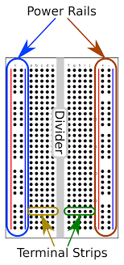
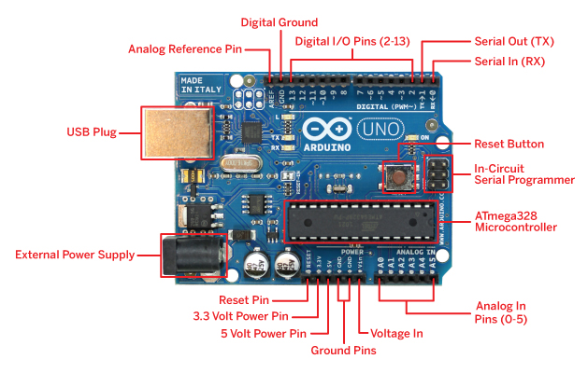
Breadboards and Arduino Basics

Slide 7
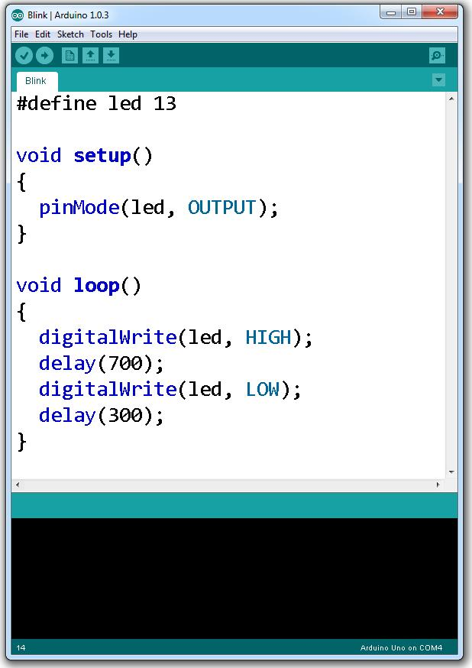
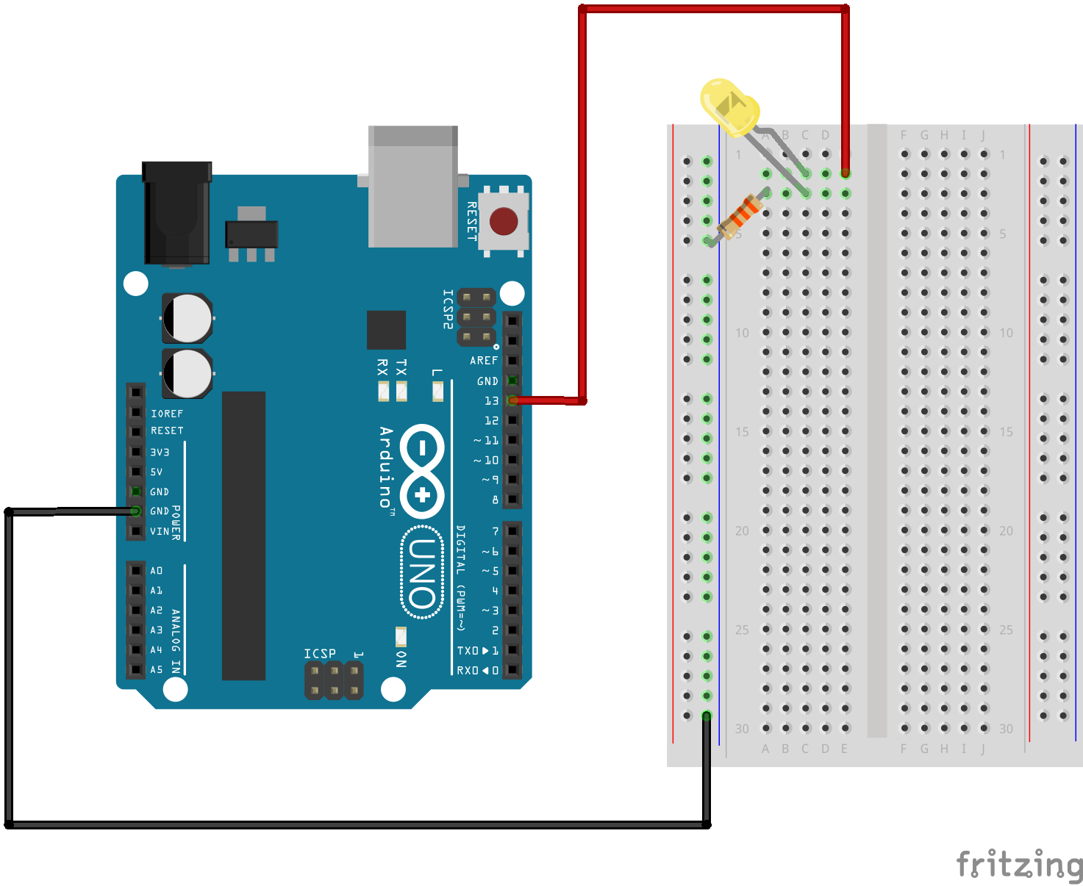
Arduino Code/Circuits
Sample codes and circuit diagrams can be found either on Arduino or Sparkfun’s Website.

Slide 8
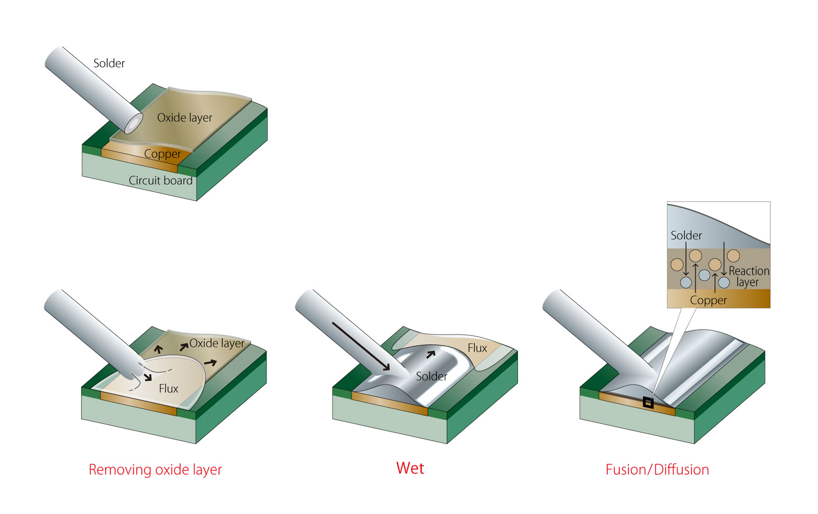
Soldering Basics

Slide 9

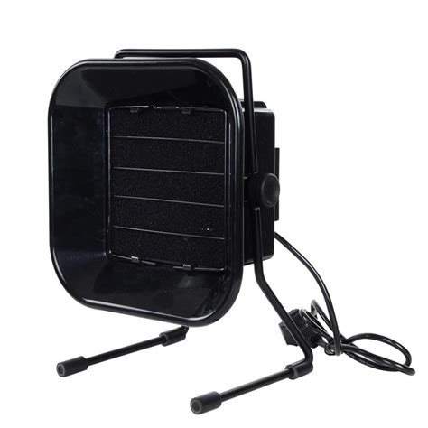
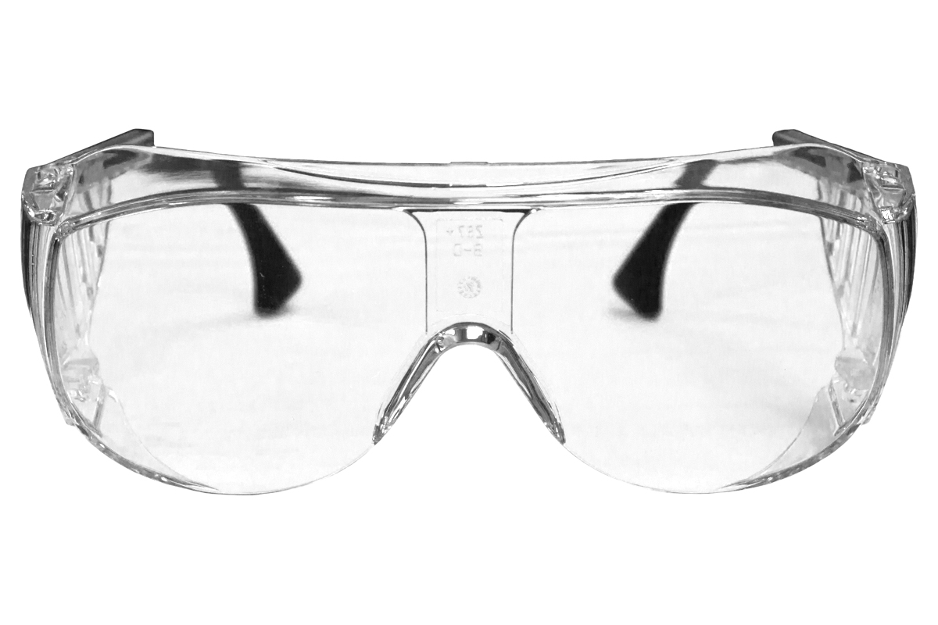
Soldering Safety
Exhaust Fan
Safety Goggles
Heat-Safe Gloves

Slide 10
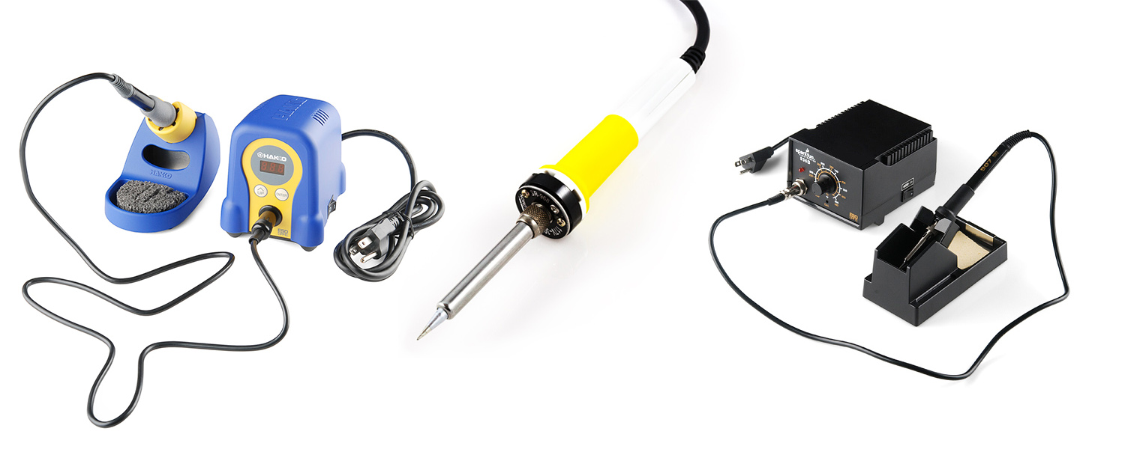
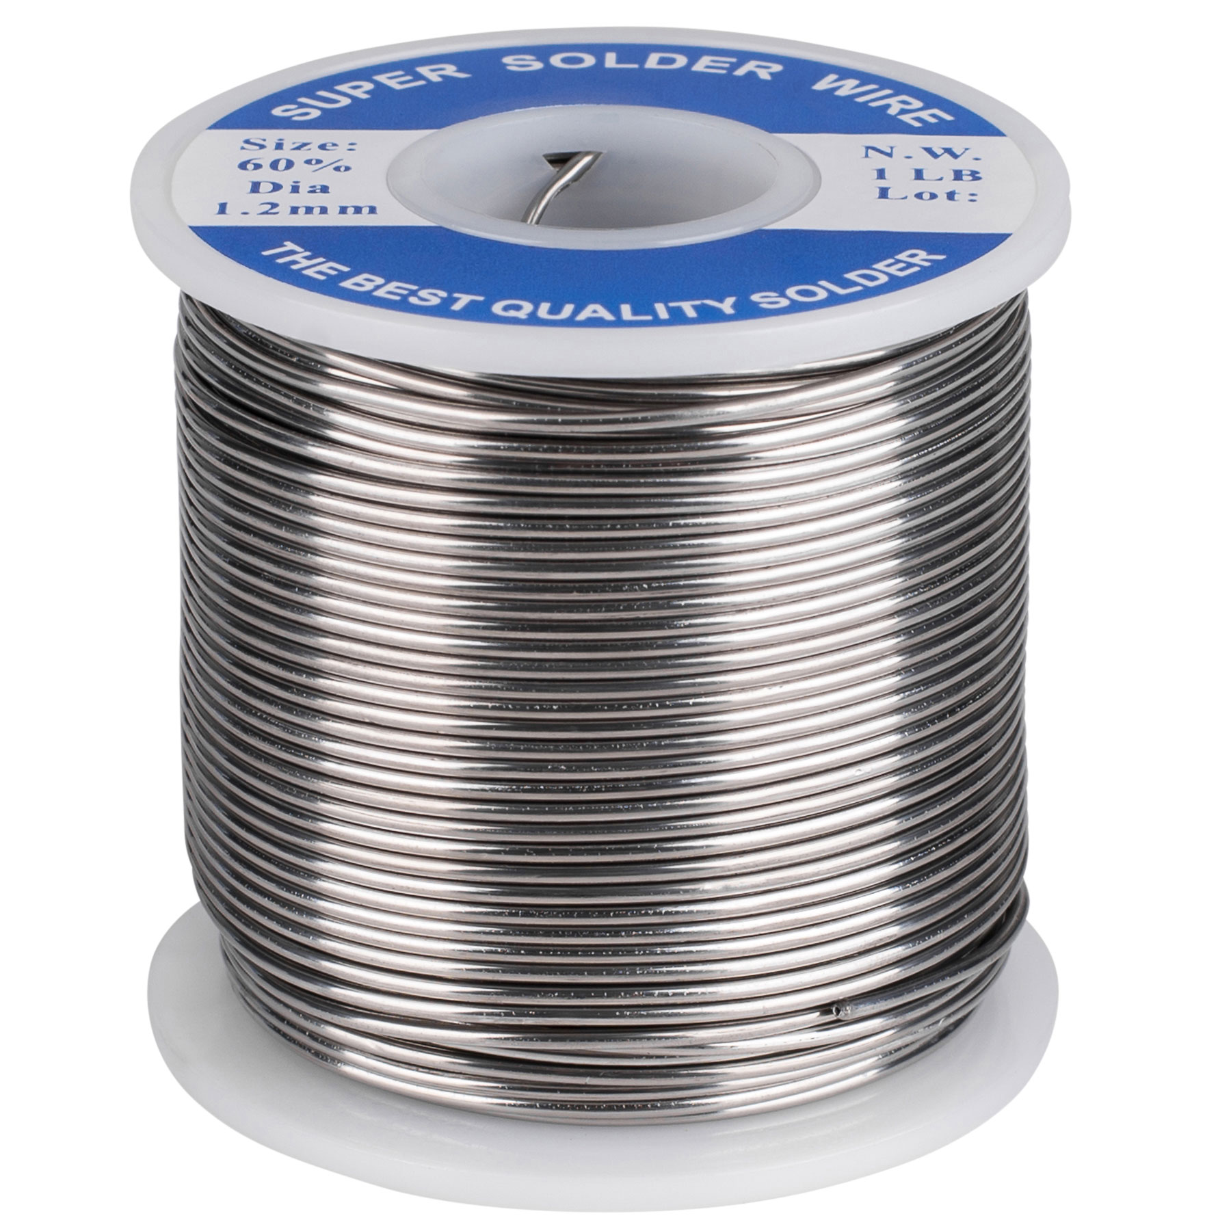
Soldering Tools
Solder Gun
Solder

Slide 11
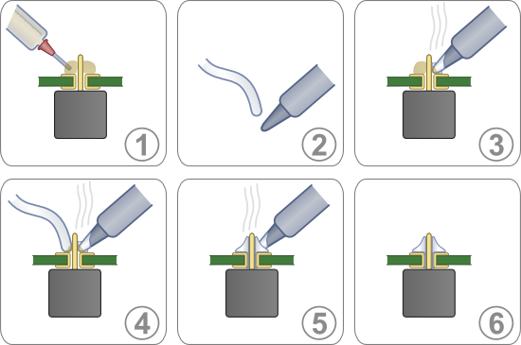
Soldering Boards
Notes:
flux for soldering

Slide 12
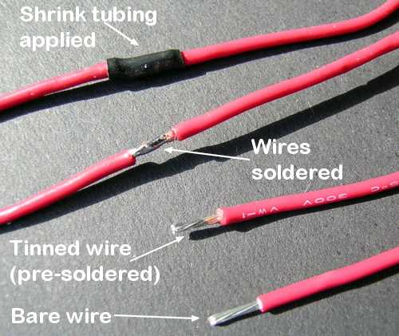
Soldering Wires

