Slide 1
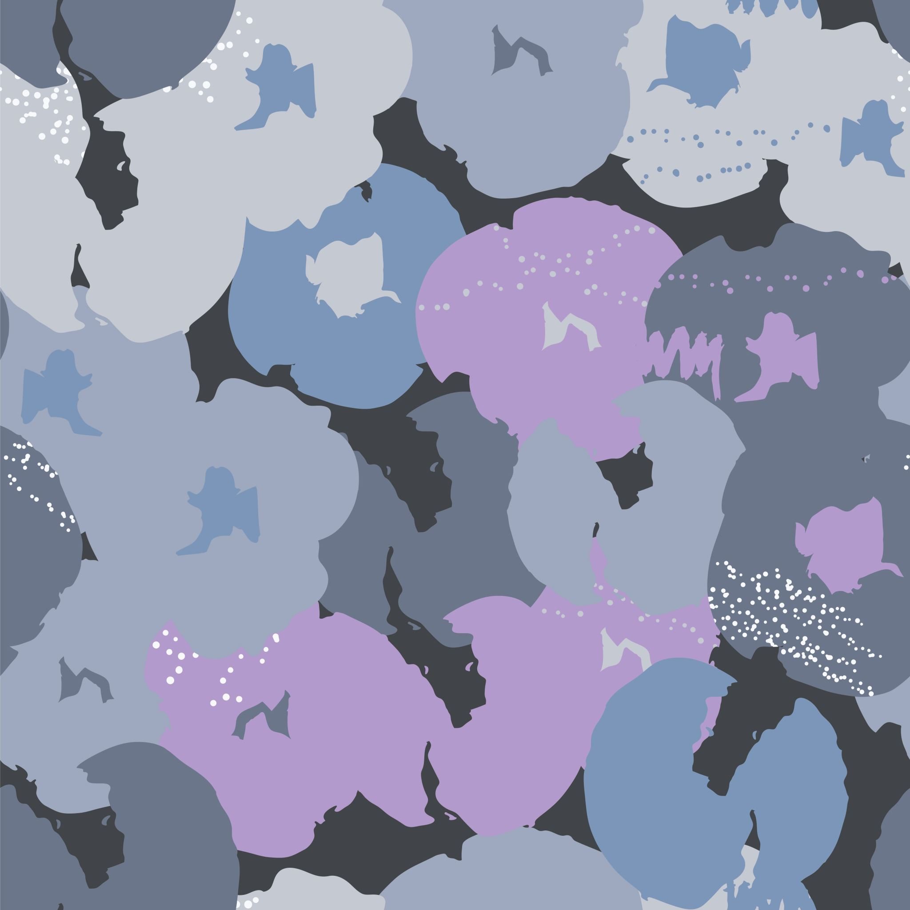
From Living Sickness to Alien Abductions
NEUROQUEER DEMI-RHETORICITY AND LYRICAL MIMESIS

Slide 2
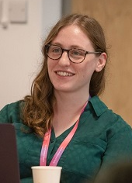
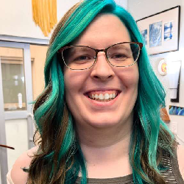
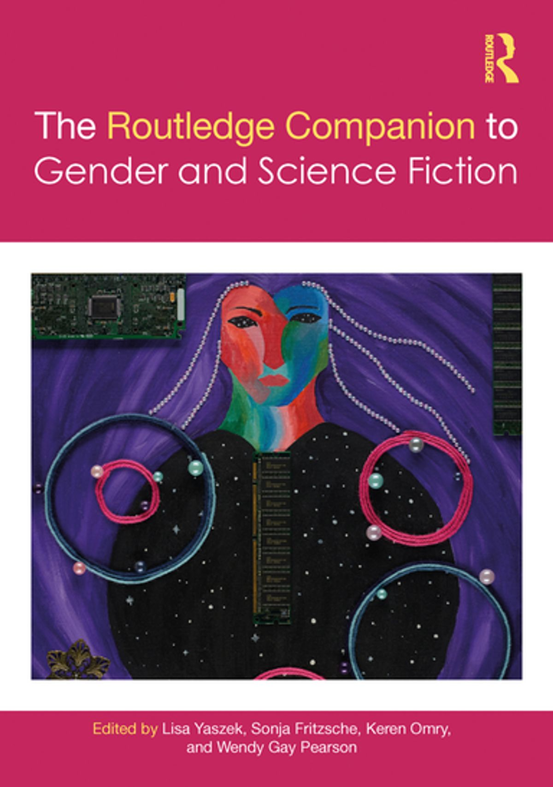
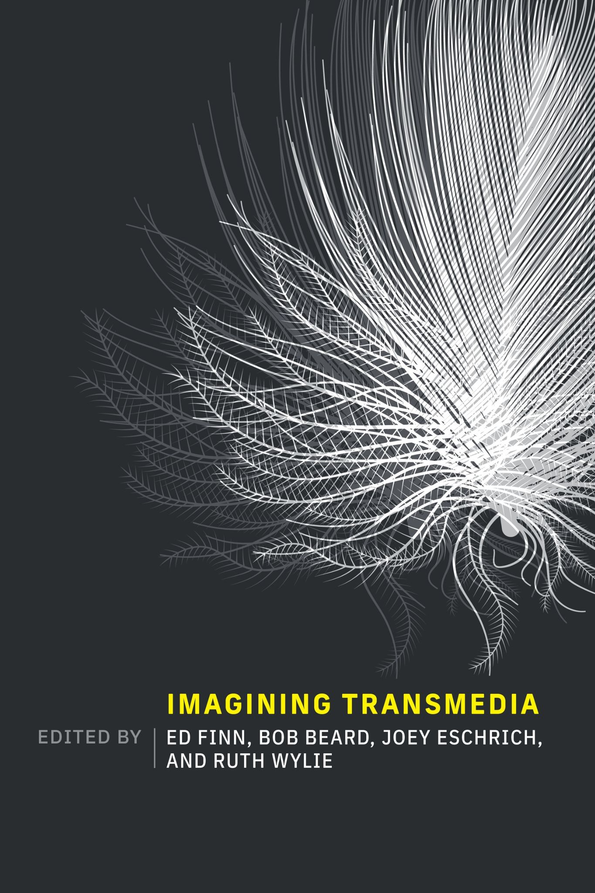

Support a New Scholar (Track A)
2023-2024
Academic Publications
Notes:
This research is possible due to the SFRA Support a New Scholar fellowship. Which I share the honor of sharing with the first ever cohort of award winners: Nora Castle and Yilun Fan. Without it I would not have had the opportunity to dig so deeply into the connections between Science Fiction and Queer and Neurodivergent Experience.
This panel is a part of my continued academic research exploring how Science Fiction intersects with my experiences as an queer, neurodivergent, trans woman in the academy. More specifically how the fields of Queer Theory and Trans Studies combine with the works of Science and Speculative Fiction to provide new insights into the world.
As such, and in keeping with the theme of this conference, this topic im discussing is an investigation into a transition in understanding for both science fiction and neurodivergent perspectives. How through the estrangement brought about by being visible and sharing their stories neurodivergent and queer individuals practice science fiction in their daily life by creating new realities in hopes of one day making them real.

Slide 3
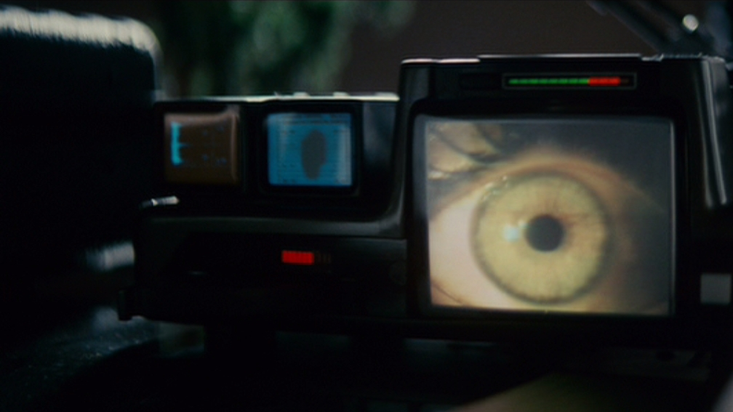
"… radical new considerations of the poetics and aesthetics of autistic expression in popular culture."
...via narratives which openly explore neurological difference, and an audiovisual aesthetic which attends to sensory pleasures and intensities”
David Hartly
Notes:
In his article “Is this to be an empathy test?” from Science Fiction Film and Television 15 (2022), David Hartley explores how Remi Yergeau and Julia Miele Roa's research have “moved critical autism studies towards radical new considerations of the poetics and aesthetics of autistic expression in popular culture.” Through an investigation of Blade Runner from a pro-disability framing, Hartley situates these new poetics as “productive partnership with fantastical cinema via narratives which openly explore neurological difference, and an audiovisual aesthetic which attends to sensory pleasures and intensities.”

Slide 4
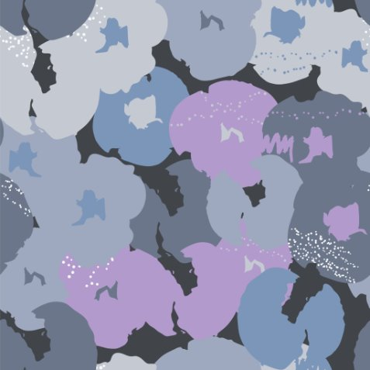
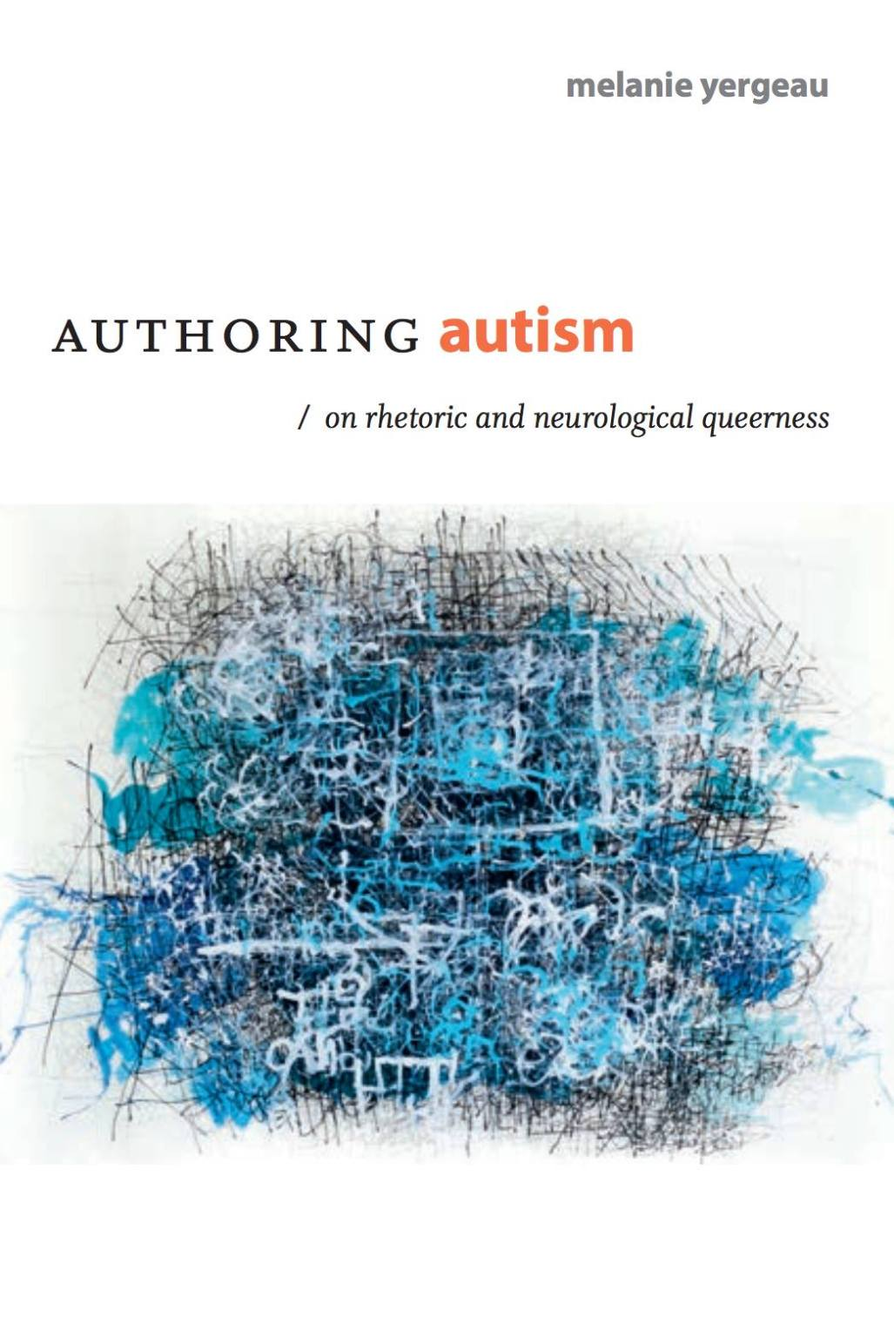
Which Autistics Can Talk?
Not Autistic Enough
Too Autistic
Quantum State of Autism
Notes:
I myself would step back and focus on a different aspect of Yergeau's work and its potential relation to science fiction. In their book, Authoring Autism (2022), Remi Yergeau describes a medicalized view of autistic individuals as entangled between two states of being simultaneously: not disabled enough to talk about their conditions, or a living manifestation of the concept of autism to disabled and without humany. This structure provides an easily exploitable method for ignoring and or rejecting any individual with the condition, as this paradoxical state of too little yet also too much forcefully remove autistics ability to speak for themselves and shifts control of the narratives about those without the conditions.

Slide 5


Demisexuality
Demigender
Notes:
Yergeau’s challenges this quantum state with the concept of demi-rhetoricity which borrows from the queer concept of “demi” as experienced by demi-sexuals and demi-genders within 2SLGBTQIA+ communities. Existing between a “not” and “have” spectrum of sexual or gender orientation, these demi identities experience a similar quantum state of being as the one imposed upon autistics individuals. However, unlike autistics, individuals with this demi-orientation stand as lived experts in their manifestation of gender and or sexuality as they are the only ones in the world who can describe what and how their relationship with gender and or sexuality manifests.

Slide 6
Quantum Autistic
Demigender
Demisexuality
Experts in Manifestation
Notes:
It is this “lived expert” state of queer demi’s Yergeau adopts as a challenge the medicalized, dismissive view of autistic individuals. By re-framing the autistic experience away from the binary state of too little or too much into a queer, fluid spectrum akin to a demi state of being, Yergeau shifts the power of autistics individuals such that they exist in a demi-rhetorical state occupying all aspects between the “not disabled enough” and “too disabled” spectrum thus allowing each individual to speak as an expert on their unique manifestation and lived experience of their conditions.

Slide 7
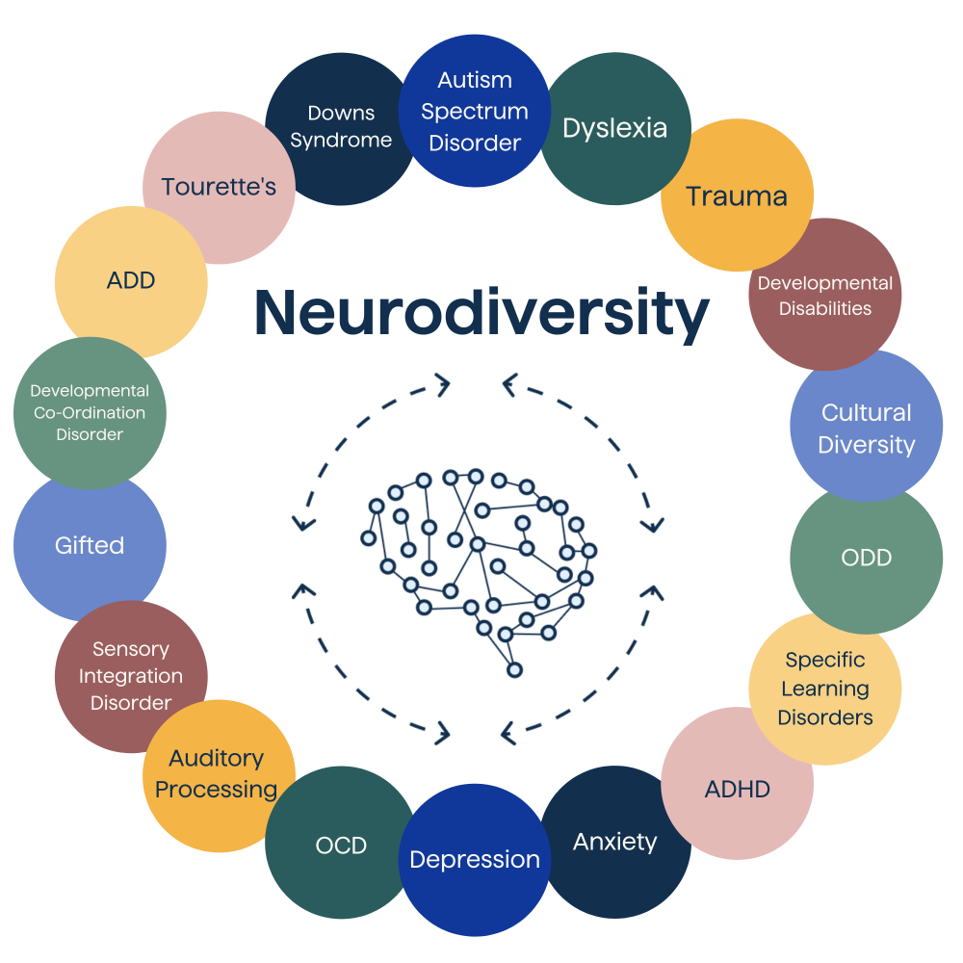
Notes:
However the state of quantum humanity exists now only for autistics but also extends to other conditions such as developmental-difference conditions like Attention Hyper Deficit Disorder (ADHD) or trauma disorders like Post-Traumatic Stress Disorder (PTSD).
United by the understanding that their mental conditions diverge from the norms of society, these divergent groups band together under the umbrella term neurodivergent for protection. Acting in a similar manner to the word queer within 2SLGBTQIA+ circles, neurodivergent becomes a shelter for individuals who do not wish to identify the specifics of their lives to outsiders and a tool to be donned and discard as situations need.
And with Yergeau’s concepts of Demi-Rhetoricity, neruodviergents have another tool to express themselves to the outside world. As the reframing it provides returns self-advocacy to the individual, giving the various groups and people under the neurodivergent umbrella a chance to express themselves to the wider world.

Slide 8
​“Science fiction has proved a fertile ground for the exploration of neurodiversity: some authors have created new types of neurodiversity — such as "hyperempathy syndrome" in Octavia Butler's Parable of the Sower (1993) — and others have included characters who are neurodiverse without labeling them as such. ... The well-known popularity of science fiction among neurodiverse people may stem partly from identification with such characters, as noted by, for instance, the autistic authors Temple Grandin and Dawn Prince-Hughes.” (p.233)
Notes:
However, Yergeau does not cover how neurodivergent individual might express their demi-rhetorical expertise. Instead it has fallen to researchers such as David Hartley’to explore what these expressions of demi-rhetoricity might look like. Notably science fiction historians have also noted a correlation between neurodivergence and science fiction writings. As Sarah Boslaugh discusses:
“Science fiction has proved a fertile ground for the exploration of neurodiversity: some authors have created new types of neurodiversity and others have included characters who are neurodiverse without labeling them as such. ... The well-known popularity of science fiction among neurodiverse people may stem partly from identification with such characters, as noted by, for instance, the autistic authors Temple Grandin and Dawn Prince-Hughes.” (p.233, Bolsaugh 2009)
While this research implies a history of connection between neurodivergence and science fiction it does not answer my question: What are the aspects of speculative fiction that call to and provide a safe haven for some neurodivergent individuals to express themselves?

Slide 9
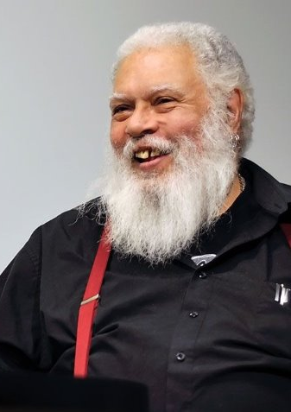
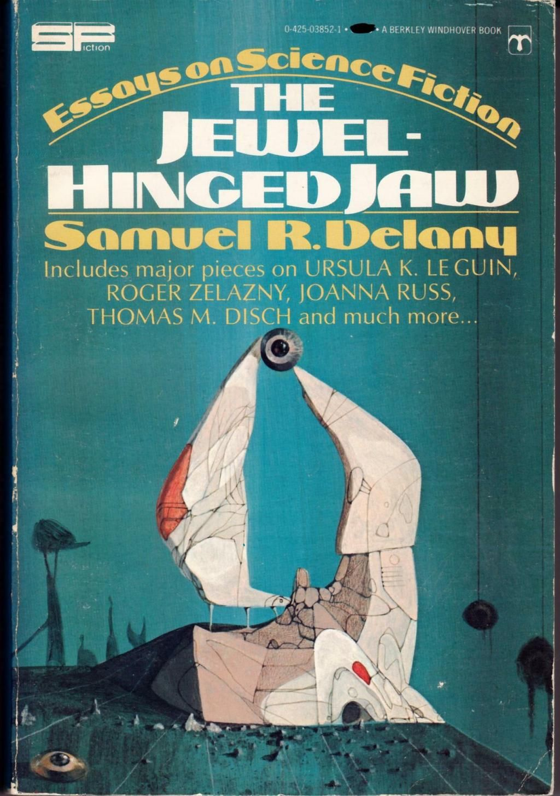
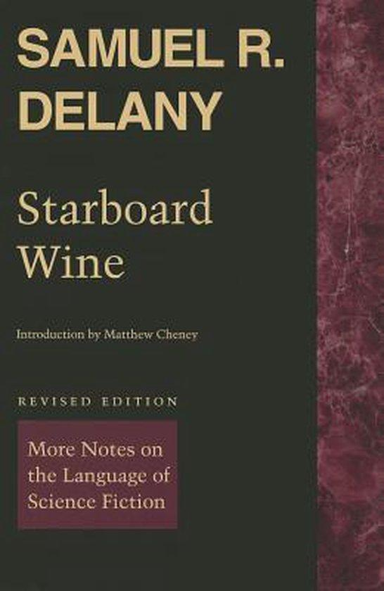
Notes:
I believe the start to this work can be found in the works of by Samuel Delaney and his view of the lyrical nature of science fiction. Delaney saw science fiction as more lyrical in its usage of language than literature, instead of having a single divorced set of meanings or metaphors, the stories of science fiction contained simultaneous multitudes. To highlight this point Delaney uses the phrase “her world exploded” to show how, when used within science fiction, the mental image it conjures within the readers can be metaphorical, literal, or both at the same time. This lyricism forces science fiction readers to adapt to and constantly interpret the media as they engage with because at any point previously established aspect of the story could reveal itself to be a new layer of literal or metaphorical writing.
If we return to Yergeau’s concept of demi-rhetricity, Delaney’s view of science fiction lyricism provides an active incitation for neurodivergent and minorities to express themselves within science fictional framings. Afterall if there is a struggle to accepted as a person by neurodivergent individuals in the real world, what safer place to express those experiences of than in lyrical manifestations of a new world?
In those world not only can these individuals’ unique manifestation of their conditions be reframed into metaphors others might come to understand, their lived experiences can also be expressed literally obfuscated through the assumption of metaphor by said readers. Thus without fear of reprisal the works of science fiction offer its readers multiple, unique perspectives within their story worlds while also offering a protective shield for the author to express their “unbelievable reality” which readers can interpret as believable unreality.

Slide 10
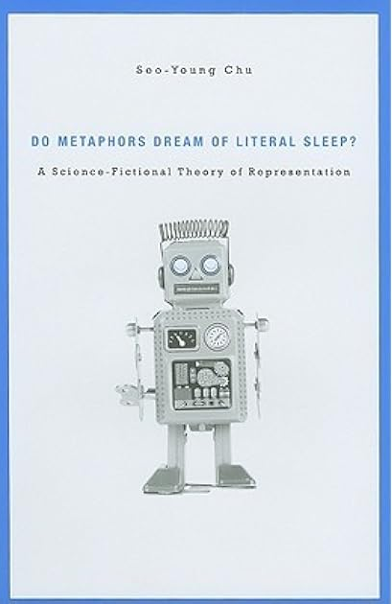
Science Fiction is a representation technology powered by a combination of lyric and narrative forces that enable SF to generate mimetic accounts of cognitively estranging referents.” (p.73)
Notes:
While Delaney’s work provides a foundation for understanding science fiction as lyrical in nature and the concept of reading for science fiction, he does not provide a full reasoning why neurodivergent individuals might use science fiction as a method to share their lived expertise with their conditions. While Delaney’s provides some aspect to share their experiences, it still lacks the connectivity for the cultural manifestations of neurodivergence experiences. As such, Seo-Young Chu theory of representation can act as a bridge between Delaney and Yergeau finally providing a vision of neurodivergent experience to include not only ambiguous experience but also narratives focused on traumatic and or the culture experience of neurodivergents, and language to express how non-neurodivergence to more easily engage with and expand their understanding of neurodivergent perspectives.
In her book, Do Metaphors Dream of Literal Sleep?, Chu expands upon Samuel Delaney’s original framing of Science Fiction as lyrical in nature.
Science Fiction is a representation technology powered by a combination of lyric and narrative forces that enable SF to generate mimetic accounts of cognitively estranging referents.” (p.73)
Chu expands Delaney’s lyrical framing to include media forms bringing examples of how this lyricism can provide visions of a reality that might be impossible for an individual to conceptualize with their lived experiences through metaphors. While Chu does concede that most of these visions have been used in relation to new worlds of technology, such as the conceptualization of Cyberspace and the Internet in the 90’s and 00’s, she dedicates two chapters of her book on cultural concepts and traumatic conditions.In these chapter Chu examines how science fictions lyricism provided individuals with these isolating condition and or unique culture experiences metaphors which readers not only resonate with, but even come to understand in-part what living with these conditions are like.

Slide 11
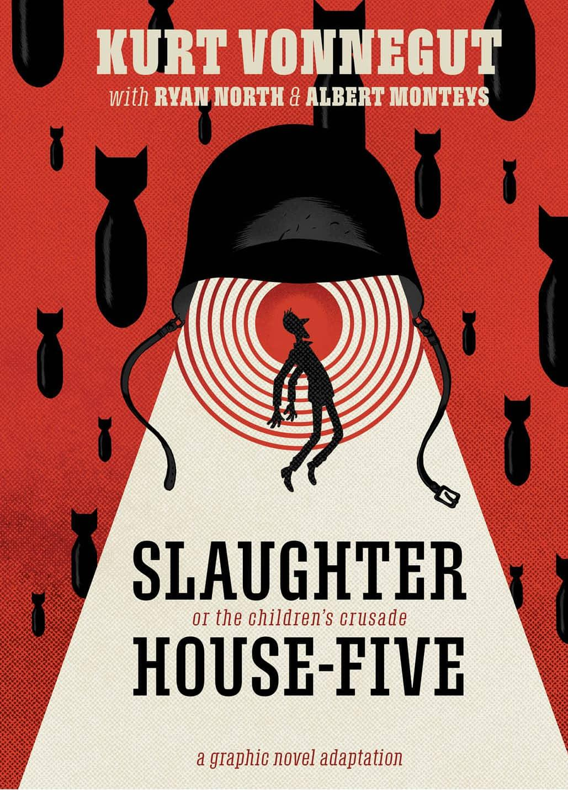
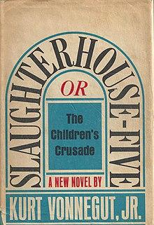
Notes:
In the chapter, “War Trauma,” Chu focuses on science fiction as metaphor for traumatic conditions. In this section she cites Kurt Vonnegut's semi-autobiographical novel Slaughterhouse-Five. The novel leads the reader through the life of Billy Pilgrim as he survives the horrors of WWII, time travel, and alien abductions. While science fiction in tone and telling, Vonnegut's narrative paints powerful metaphors for his experience living with PTSD as a result of his WWII deployment. As previously stated, PTSD is included in the umbrella term of neurodivergence due to altering of the sufferer's brain due to traumatic experience.
According to Chu, Vonnegut’s technique of fictionalizing his lived experiences with science fictional elements provides readers with a more emotionally resonant understanding of PTSD, despite it never being explicitly stated within the narrative. And while this chapter alone provides a welcome expansion of how neurodivergent experiences can be read and made within science fiction experience, Chu’s next chapter provides us with a way to not only allow neurodivergents to tell stories based on their identities, but also to share stories based around the culture and communities which neurodivergency have built presently and historically.

Slide 12
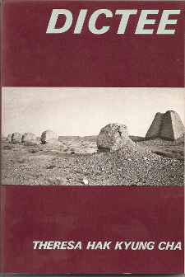
“Han,” a word with no equivalent in English, refers to a Korean form of grief. According to Ishle Yi Park, “All Koreans feel it” because “our country has always had to shut up and listen to bigger countries” and “because of the war that split brother from sister and left everyone’s family missing or dead.” (p. 71-72)
Notes:
In “Postmemory Han,” Chu describes how speculative fiction metaphors can be used to describe unique cultural experiences. The focus of this chapter is Han, a cultural emotion unique to Korean culture. The experience of Han, as Chu describes, is difficult for individuals outside Korean culture to understand, however, through science fiction’s lyrical nature it might be more easily understood as a condition that can be passed down through families as a genetic disease or transference in the blood.
For example Chu describes Theresa Hak Kyung Cha Dictee (1982), invokes post-memory han by figuring herself as a bionic telepath who recalls distant events (e.g., her mother’s near-death experience while exiled in Manchuria) with photographic exactness or Suji Kwock Kim “Notes from the Divided Country (2003)” which renders postmemory han available for representation by describing it as a genetic condition. Made of “chromosomes” and “cells of history,” her parents’ han-filled memories permeated her body while she was in her mother’s womb. Thus, in Kim’s SF account of postmemory han, the Japanese occupation and Korean War—neither of which she experienced firsthand—have become part of her DNA.
In this lens Chu’s description of Han provides a method for describing the genetic trauma that can be passed down and experienced across generations despite some individual potentially never having to experience said traumas again. Through this language the postmemory expression of han is liken by Chu herself to the metaphors for Slavery as shown in Butler’s Kindred. and which I would extend to the genetic trauma experienced by individuals who have cultural or family history which contains traumatic experiences of queer or neurodivergent manifestations.

Slide 13


Notes:
Chu’s expansive reframing of Delaney’s previous concepts of lyrical science fiction provides a wider range for the inclusions of of neurodivergent and neuroqueer identities to be explored via science fictional narratives. Instead of just a written story centered on a flood of concepts and experience which constantly estrange the reader forcing them to explore, interpret and re-examine then events, Chu’s framing allows for more expansive visions of neurodivergency to bloom. Stories within Chu’s framework allow for culture, trauma, and anything else related to the neurodivergent experience to be expressed within science fictional narrative. This, finally, shows a method by which not only the personhood but also the cultural identity of neurodivergency Yergeau originally implies in her works can be found. And through these neuroqueer readings of science fiction expand histories so as to to uncover the missing and forgotten past of previous individuals or cultures who turned to the power of science fiction in a time before they were able to be acknowledged.
Future work includes a second article that builds on the reader perspective for this neuroqueer reading instead of just the author perspective. As expressed through the concept of Restorying as seen in Education and its newest adoption into Queer and Trans studies.

Slide 14
References
Hartley, David. "" Is this to be an empathy test?": Autism and neuroqueer expression in Blade Runner (1982)." Science Fiction Film and Television 15.2 (2022): 123-144.
Yergeau, M. Remi. Authoring autism: On rhetoric and neurological queerness. Duke University Press, 2018.
Chu, Seo-Young. Do metaphors dream of literal sleep?: A science-fictional theory of representation. Harvard University Press, 2010.
Delany, Samuel. "Starboard Wine: More Notes on the Language of Science Fiction." (1984).
Delany, Samuel. "The Jewel-Hinged Jaw: Notes on the Language of Science Fiction." (1977).
Boslaugh, Sarah. “Neurodiversity.” Ladenson, S. (2009). Women in science fiction and fantasy. Counterpoise, 13(3/4). https://doi.org/info:doi/

